Slide 1
YARN
Yet Another Resource Negotiator

Slide 2
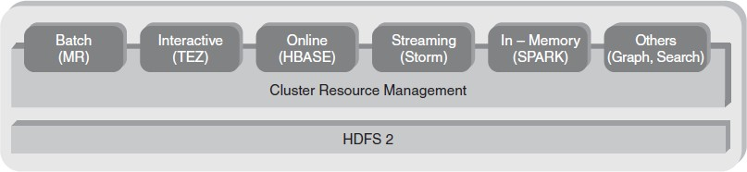
Hadoop 2 Ecosystem

Slide 3
Hadoop 2 Ecosystem Components
HDFS 2 (Hadoop Distributed File System)
The storage layer that holds large-scale data across multiple distributed nodes.
Provides fault tolerance and high availability.
Cluster Resource Management
Manages computing resources across the cluster.
Includes YARN (Yet Another Resource Negotiator) to allocate CPU, memory, and storage efficiently.

Slide 4
Hadoop 2 Ecosystem Components
Various Processing Frameworks on Top of Hadoop
Batch Processing (MR - MapReduce) → Handles large-scale batch jobs efficiently.
Interactive Processing (TEZ) → Optimized for faster query execution (used by Hive and Pig).
Online Processing (HBase) → Provides real-time read/write access for large datasets.
Streaming Processing (Storm) → Processes real-time data streams (used for IoT, logs, and event-based analytics).
In-Memory Processing (Spark) → Accelerates big data processing using RAM, reducing disk I/O.
Other Workloads (Graph, Search, etc.) → Supports graph-based computations (e.g., Apache Giraph) and search indexing (e.g., Apache Solr, Elasticsearch).

Slide 5
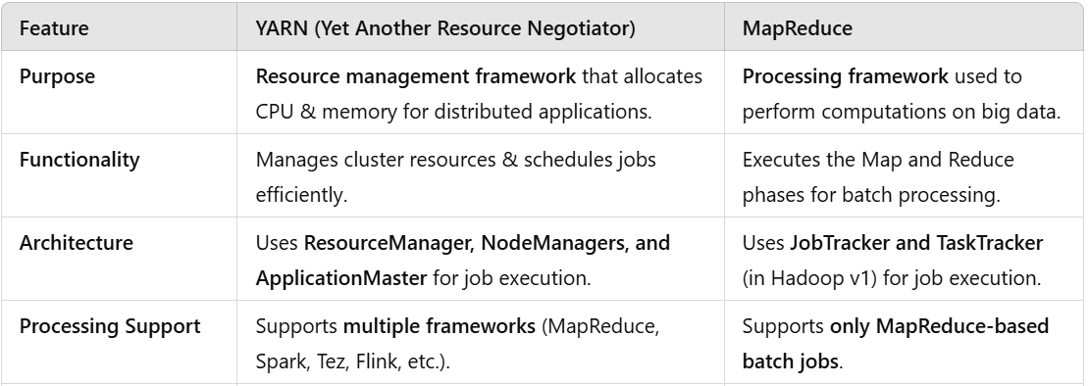
Difference between YARN and MapReduce

Slide 6
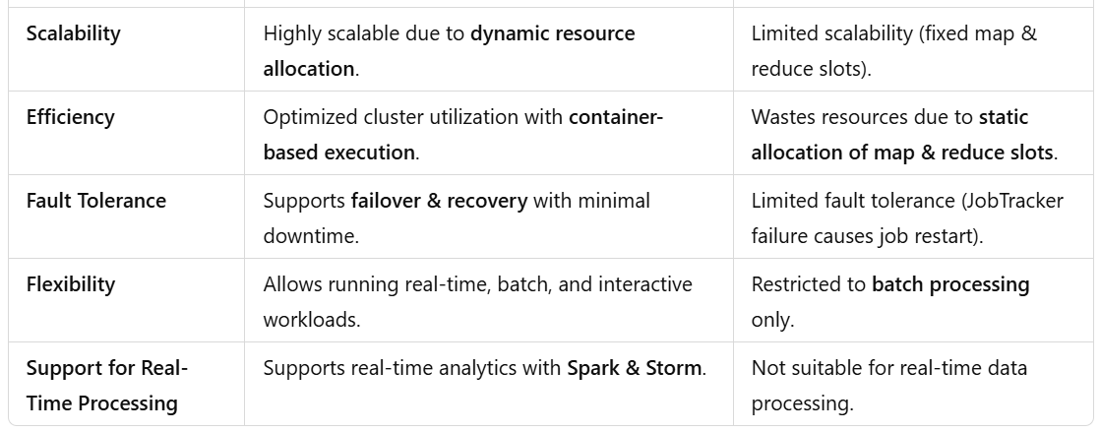
Difference between YARN and MapReduce

Slide 7
YARN
YARN is called as the operating system of Hadoop as it is responsible for managing and monitoring workloads.
It allows multiple data processing engines such as real-time streaming and batch processing to handle data stored on a single platform.

Slide 8
Components of YARN
Resource Manager: Runs on a master daemon and manages the resource allocation in the cluster.
Node Manager: They run on the slave daemons and are responsible for the execution of a task on every single Data Node.

Slide 9
Components of YARN
Application Master: Manages the user job lifecycle and resource needs of individual applications. It works along with the Node Manager and monitors the execution of tasks.
Container: Package of resources including RAM, CPU, Network, HDD etc on a single node.

Slide 10
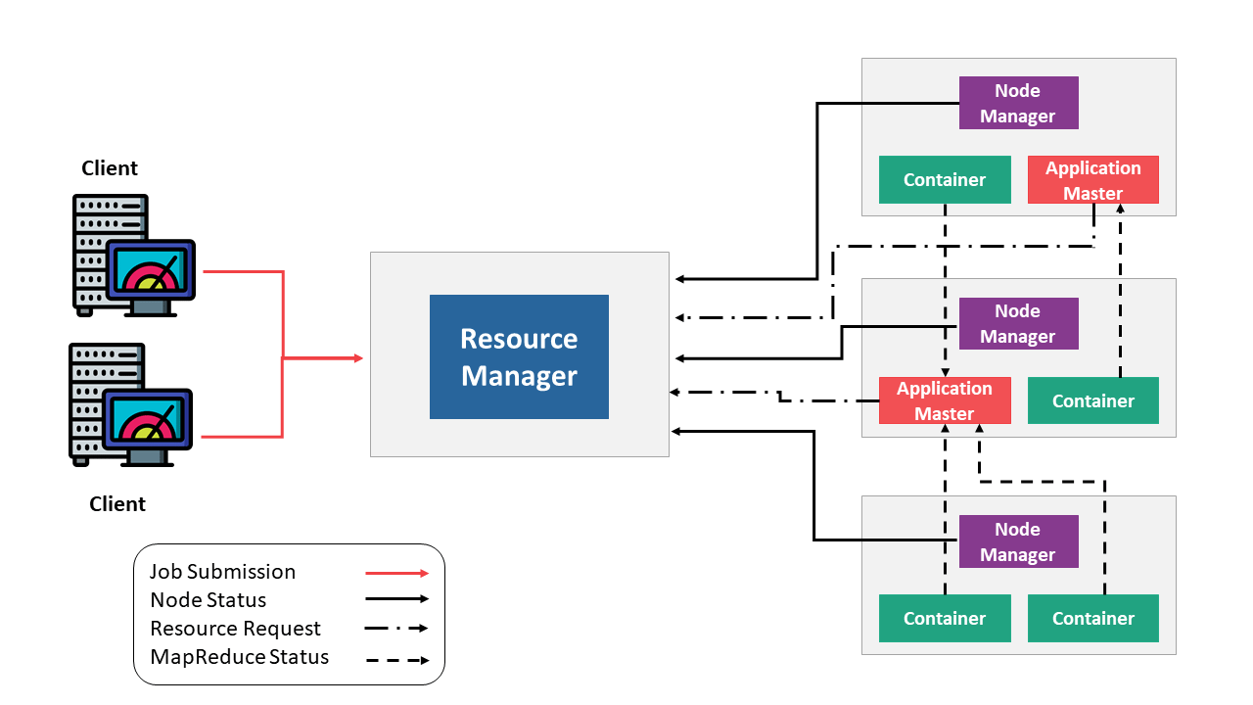
YARN Architecture

Slide 11
YARN architecture
Client
The client submits a job (MapReduce, Spark, Tez, etc.) to the Resource Manager.
Resource Manager (RM)
Acts as the central authority that manages resource allocation across the cluster.
It does not execute tasks directly but assigns them to available nodes.
It receives resource requests from applications and allocates resources accordingly.
Node Manager (NM)
Runs on each worker node in the cluster.
Monitors resource usage (CPU, memory) and reports back to the Resource Manager.
It launches and manages containers where tasks execute.

Slide 12
YARN architecture
Application Master (AM)
The client submits a job (MapReduce, Spark, Tez, etc.) to the Resource Manager.
Responsible for negotiating resources with the Resource Manager and monitoring task execution.
If a job requires multiple tasks, the Application Master requests containers from Node Managers.
Containers
Containers are resource units (CPU & memory) assigned to run tasks.
Tasks (e.g., MapReduce jobs) run inside these containers, and their status is reported back to the Application Master.

Slide 13
Workflow in YARN
Job Submission – The client submits a job to the Resource Manager.
Resource Allocation – The Application Master requests resources (containers) from the Resource Manager.
Task Execution – The Node Managers launch containers, which execute tasks and report their status.
Monitoring & Completion – The job status is continuously updated, and upon completion, the Application Master releases resources.

Slide 14
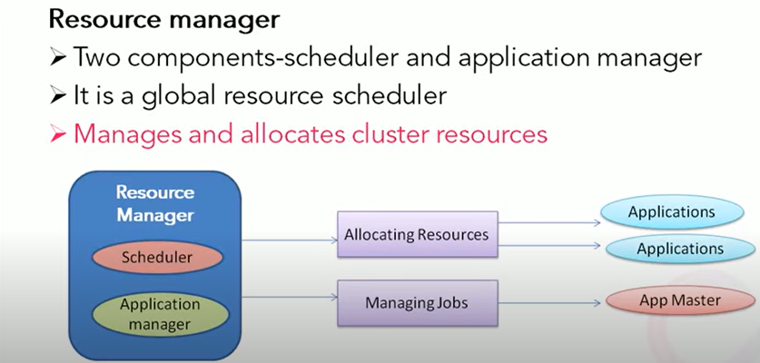

Slide 15
Resource Manager
Ultimate authority in resource allocation.
On receiving the processing requests, it passes parts of requests to corresponding node managers accordingly, where the actual processing takes place.
Optimizes the cluster utilization like keeping all resources in use all the time against various constraints such as capacity guarantees, fairness, and SLAs.
It has two major components:
(a) Scheduler (b) Application Manager

Slide 16
Scheduler
The scheduler is responsible for allocating resources to the various running applications subject to constraints of capacities, queues etc.
It is called a pure scheduler in ResourceManager, which means that it does not perform any monitoring or tracking of status for the applications.
If there is an application failure or hardware failure, the Scheduler does not guarantee to restart the failed tasks.

Slide 17
Application Manager
It is responsible for accepting job submissions.
Negotiates the first container from the Resource Manager for executing the application specific Application Master.
Manages running the Application Masters in a cluster and provides service for restarting the Application Master container on failure.

Slide 18
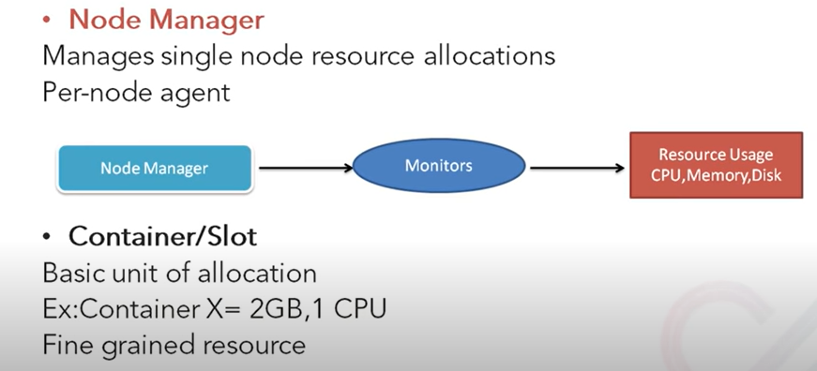

Slide 19
Node Manager
It takes care of individual nodes in a Hadoop cluster and manages user jobs and workflow on the given node.
It registers with the Resource Manager and sends heartbeats with the health status of the node.
Its primary goal is to manage application containers assigned to it by the resource manager.
It keeps up-to-date with the Resource Manager.

Slide 20
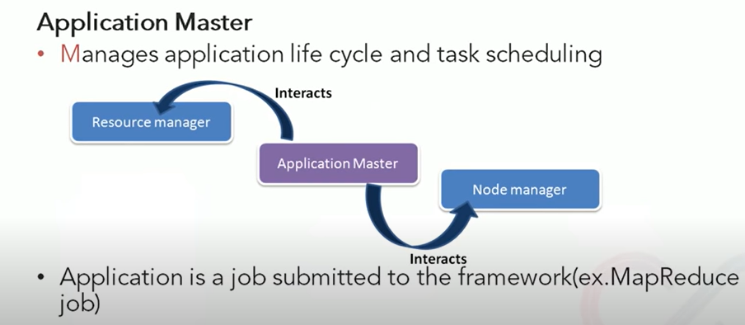

Slide 21
Application Master
An application is a single job submitted to the framework. Each such application has a unique Application Master associated with it which is a framework specific entity.
It is the process that coordinates an application’s execution in the cluster and also manages faults.
Its task is to negotiate resources from the Resource Manager and work with the Node Manager to execute and monitor the component tasks.

Slide 22
Container
It is a collection of physical resources such as RAM, CPU cores, and disks on a single node.
YARN containers are managed by a container launch context which is container life-cycle(CLC).

Slide 23
Main features of YARN
Flexibility – other applications can also be run along with Map Reduce programs in Hadoop2.
Efficiency – As many applications run on the same cluster, Hence, efficiency of Hadoop increases without much effect on quality of service.
Shared – Provides a stable, reliable, secure foundation and shared operational services across multiple workloads.
– Additional programming models such as graph processing and iterative modeling are now possible for data processing.

Slide 24
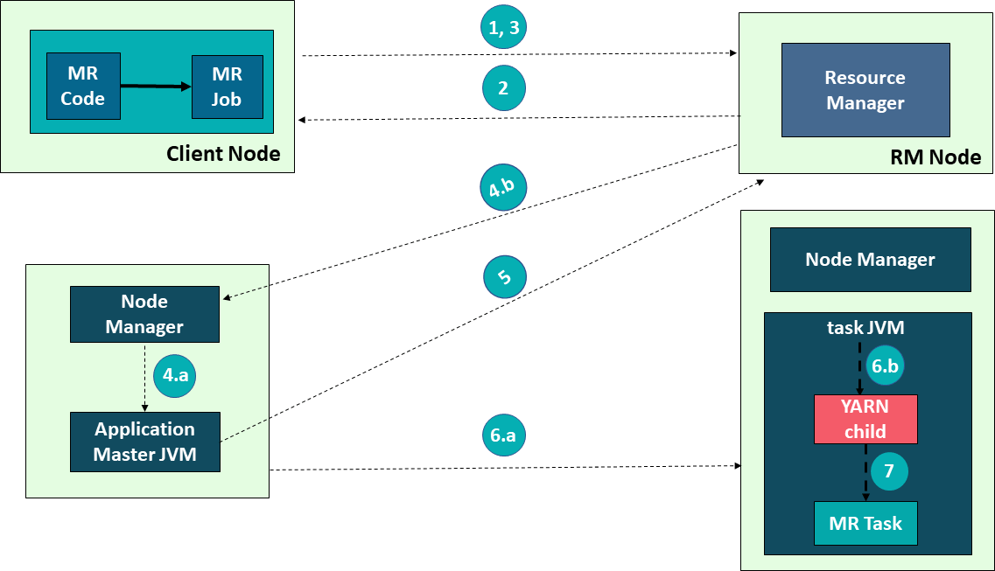
Application Workflow in Hadoop YARN

Slide 25
Application Workflow in Hadoop YARN
Following steps are involved in application submission of Hadoop YARN:
1) Submit the job
2) Get Application ID
3) Application Submission Context
4 a) Start Container Launch
b) Launch Application Master
5) Allocate Resources
6 a) Container b) Launch
7) Execute

Slide 26
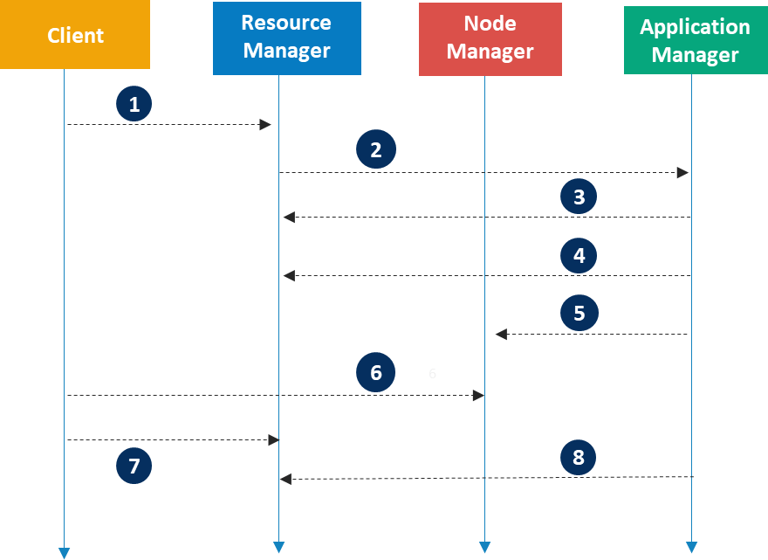
Application Workflow in Hadoop YARN

Slide 27
Application Workflow in Hadoop YARN
Client submits an application
Resource Manager allocates a container to start Application
Manager
Application Manager registers with Resource Manager
Application Manager asks containers from Resource Manager
Application Manager notifies Node Manager to launch containers
Application code is executed in the container
Client contacts Resource Manager/Application Manager to
monitor application’s status
Application Manager unregisters with Resource Manager

Slide 28
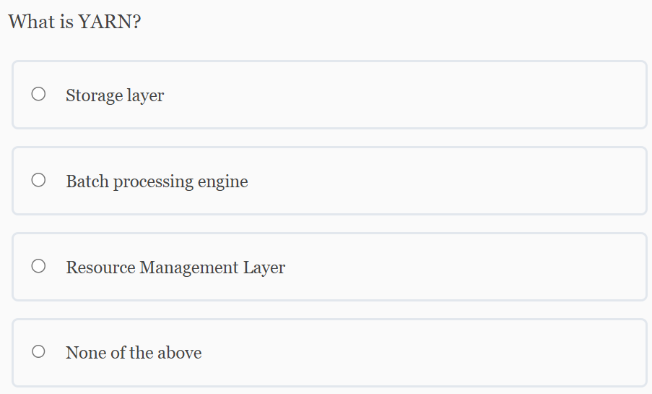

Slide 29
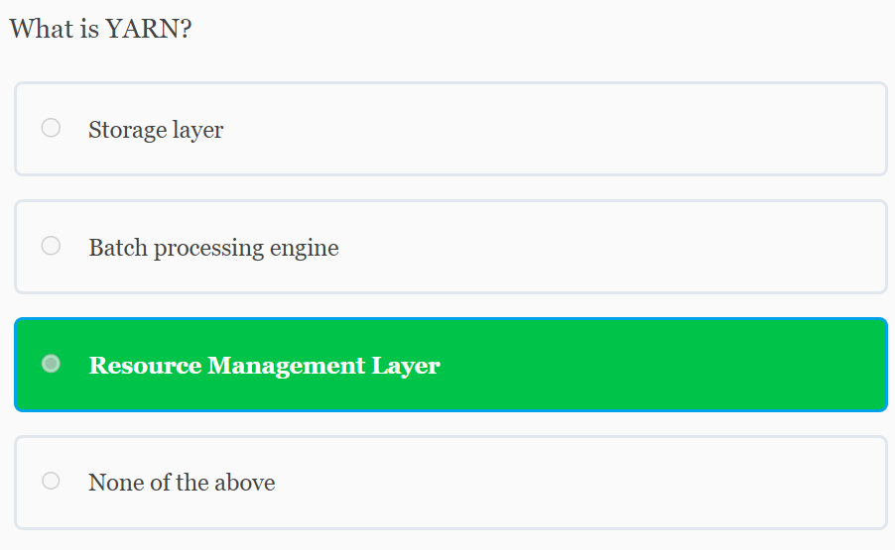

Slide 30
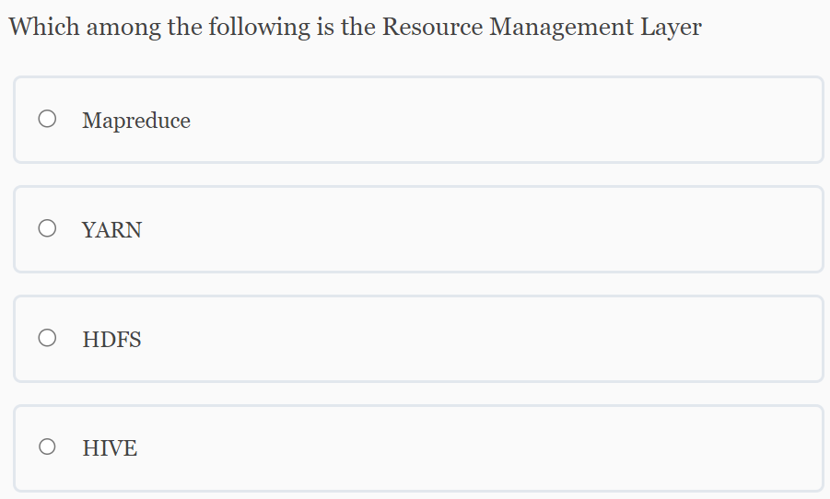

Slide 31
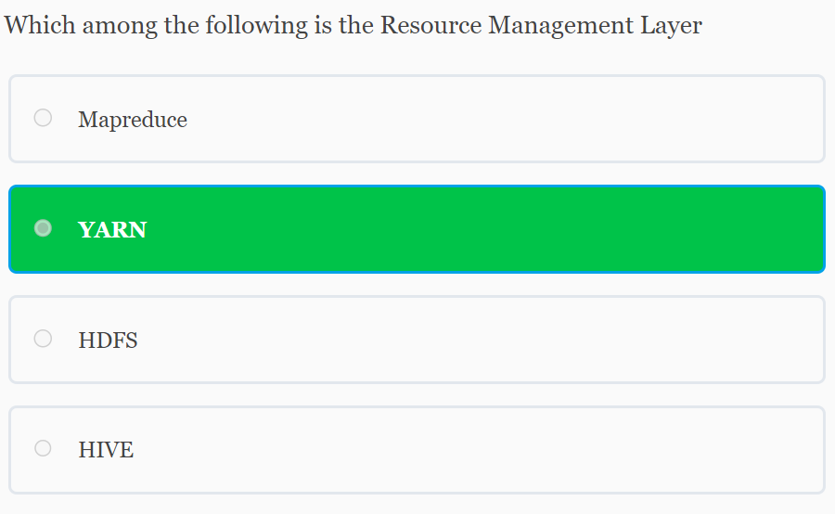

Slide 32
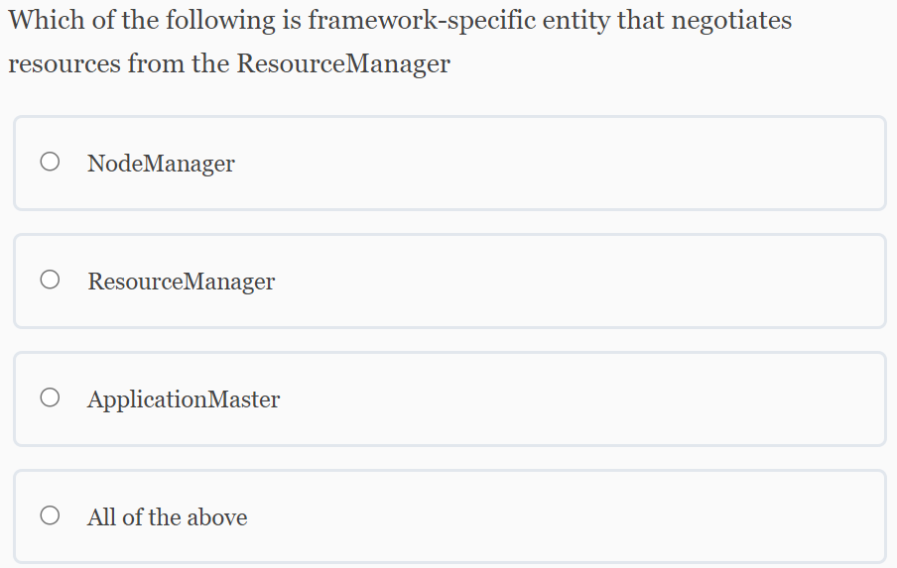

Slide 33
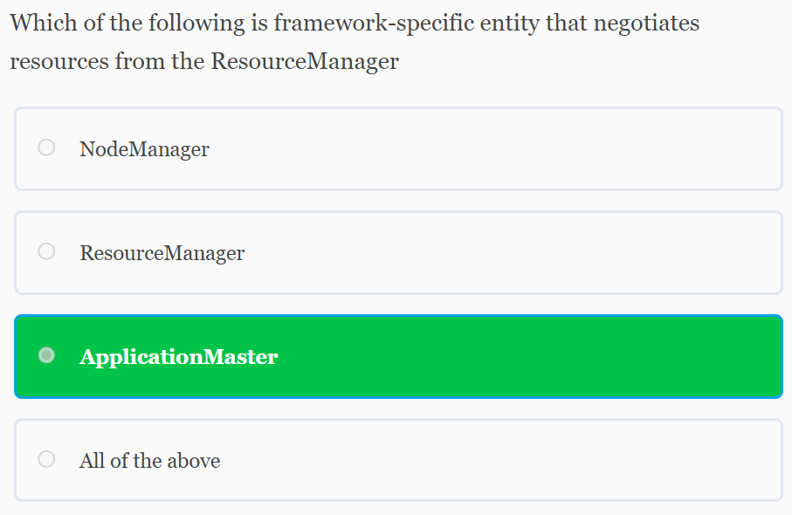

Slide 34
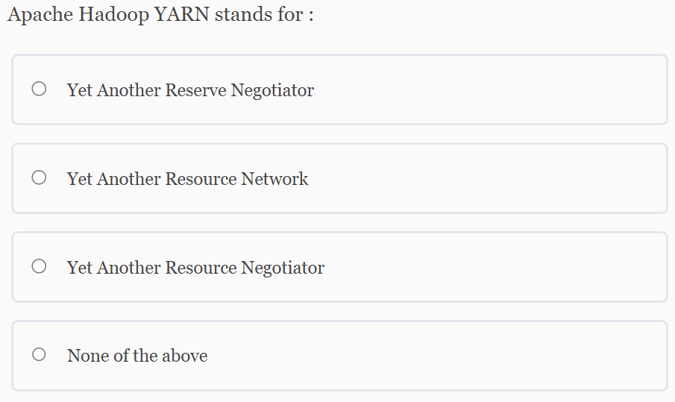

Slide 35
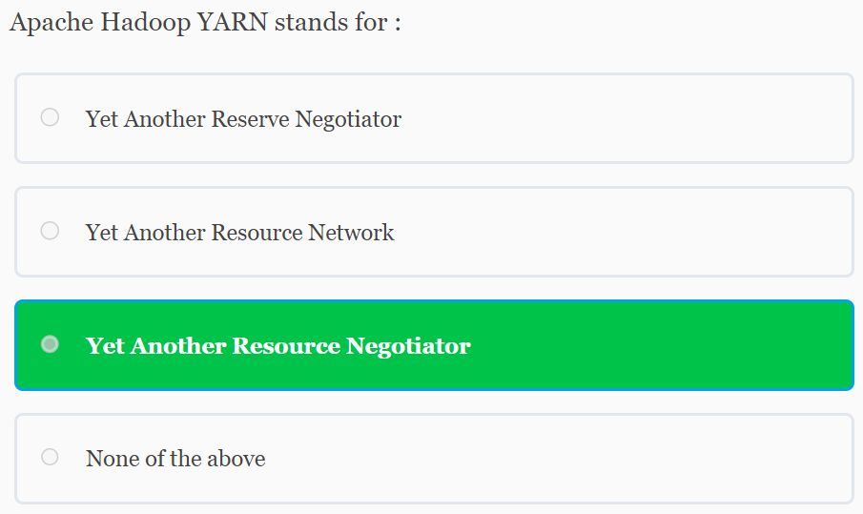

Slide 36
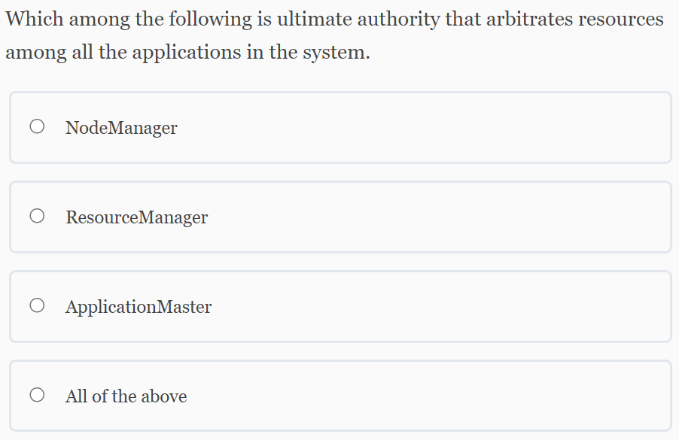

Slide 37
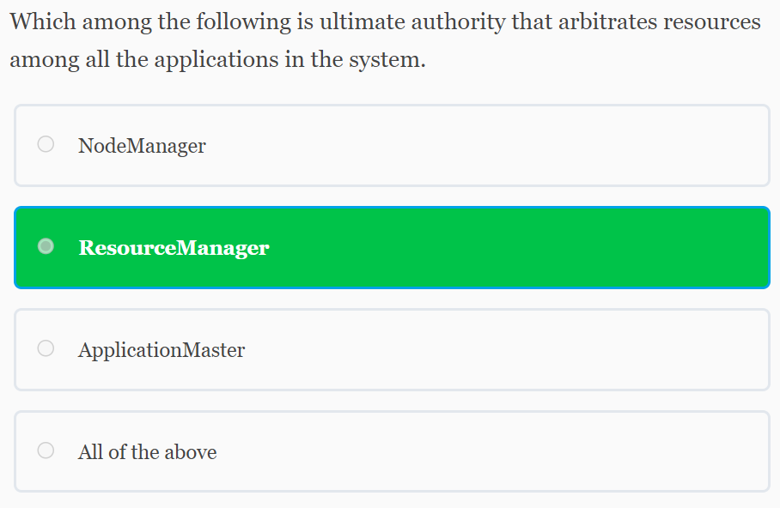

Slide 38
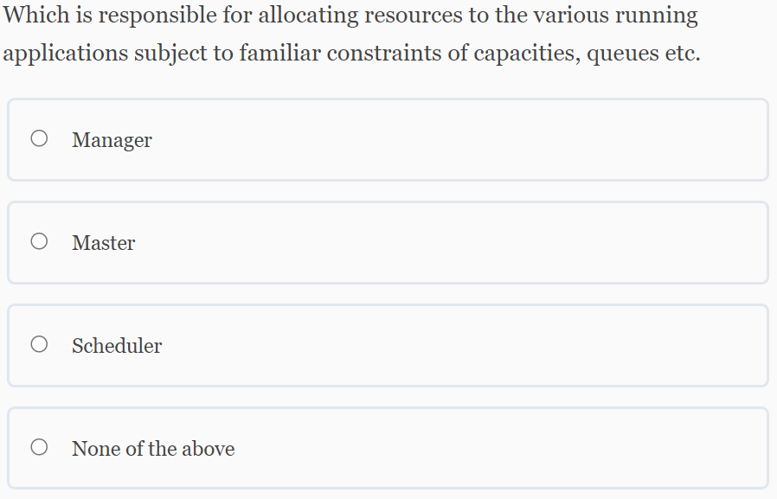

Slide 39
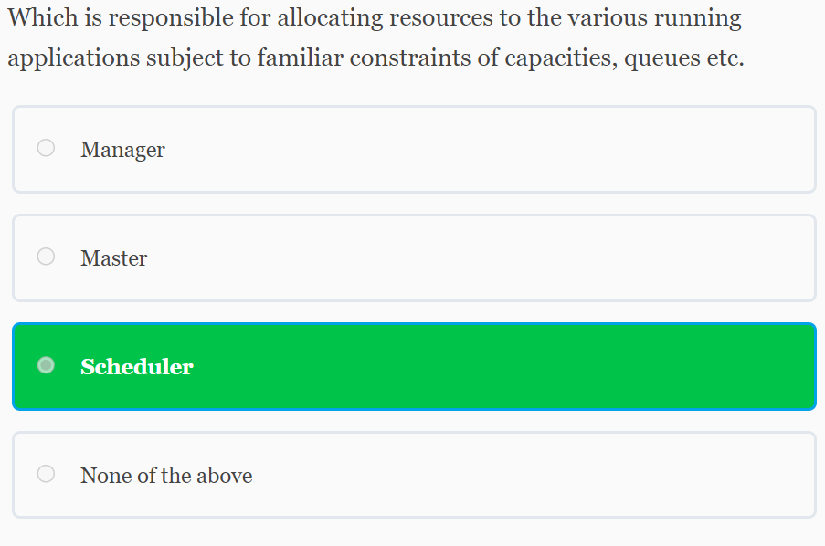

Slide 40
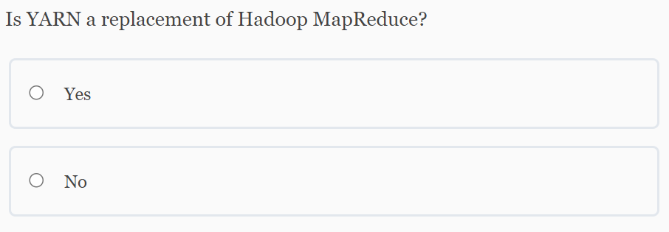

Slide 41
